Slide 1
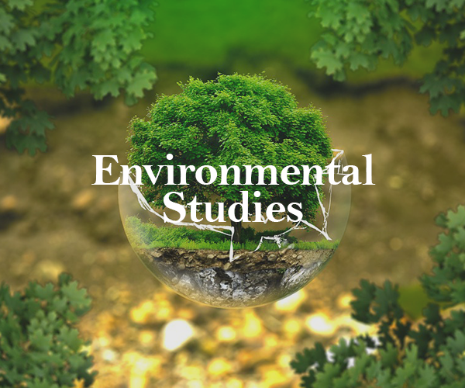
Guided / Instructed by -Prof. Aasama Shaikh

Slide 2
Group Members
1)Kadambari Ganore (06)
2)Pranjal Save (10)
3)Angel D’souza (25)
4)Prachit Save (42)

Slide 3
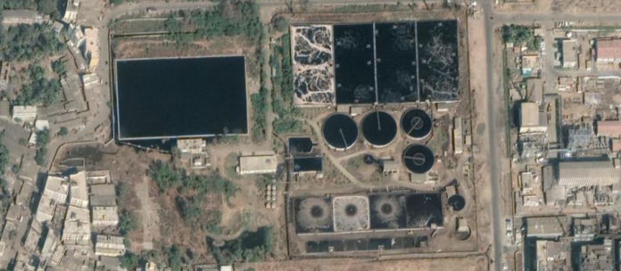

“Visit to MIDC purification plant”
Topic

Slide 4
About Company & History
Early MIDC industries in Boisar had no centralized wastewater treatment.
Each industry was responsible for its own purification plant, but many lacked proper systems
To address pollution concerns, the government established the Tarapur Environment Protection Society Plant.
Promotes eco-friendly practices in the industrial sector.

Slide 5
Objective To Visit Plant
The textile industry significantly contributes to global economic growth.
However, it generates large amounts of wastewater, which poses environmental and health hazards due to toxic pollutants.
Wastewater contains heavy metals and harmful chemicals from dyeing processes.
These pollutants are harmful to aquatic ecosystems and human health.

Slide 6
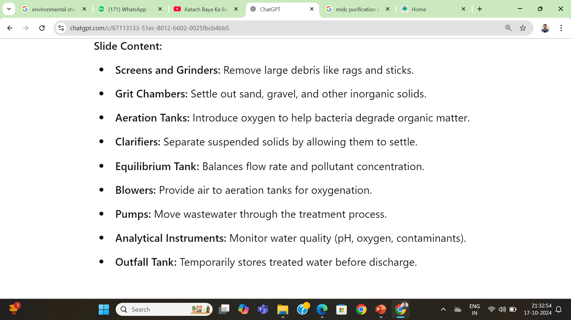
Machinery Used

Slide 7
Treatment Stages
Primary Treatment:
Screening & Grit Removal: Removes large debris and inorganic solids.
Machinery: Screens, grinders, grit chambers.
Secondary Treatment:
Aeration: Promotes bacteria growth to degrade organic matter.
Clarification: Settles suspended solids.
Machinery: Aeration tanks, blowers, clarifiers.

Slide 8
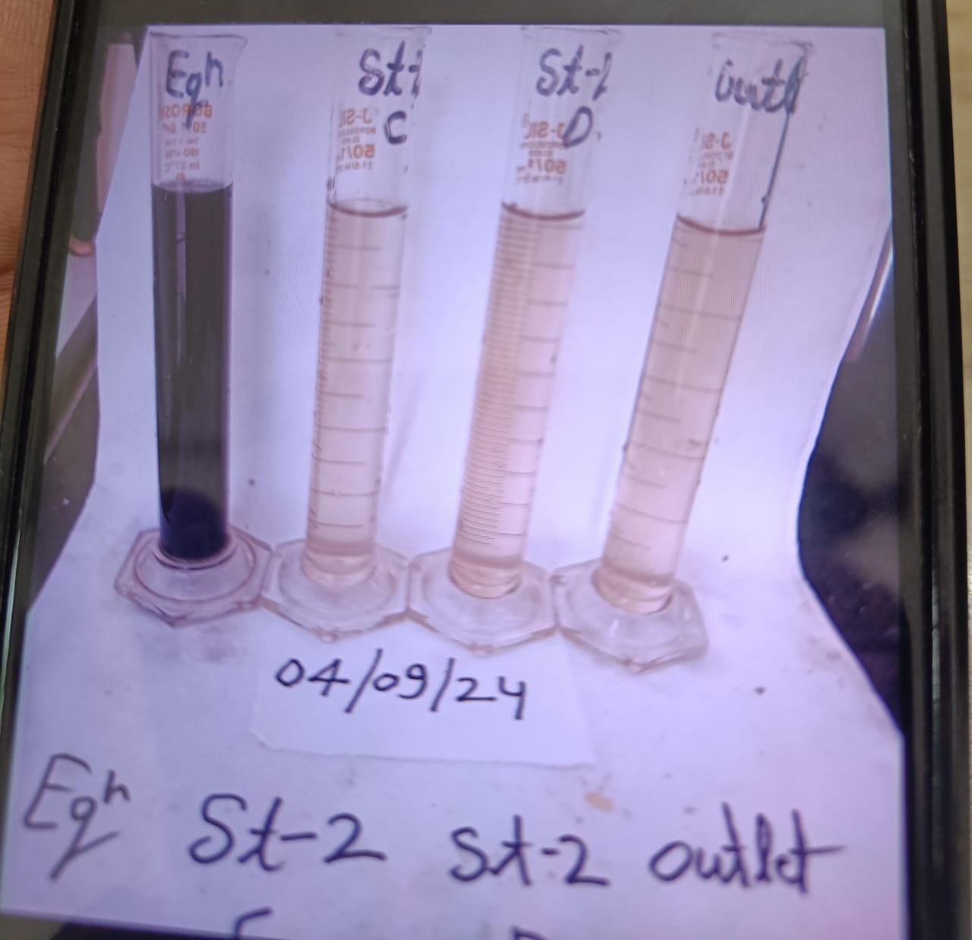
Tertiary Treatment (Optional):
Filtration: Removes smaller particles.
Disinfection: Kills harmful microorganisms.
Machinery: Filters, UV units.
Sludge Treatment:
Reduces and dewaters sludge for disposal.
Machinery: Thickeners, dewatering equipment.
Effluent Discharge:
Releases treated water into natural bodies.
Machinery: Discharge pipes.

Slide 9
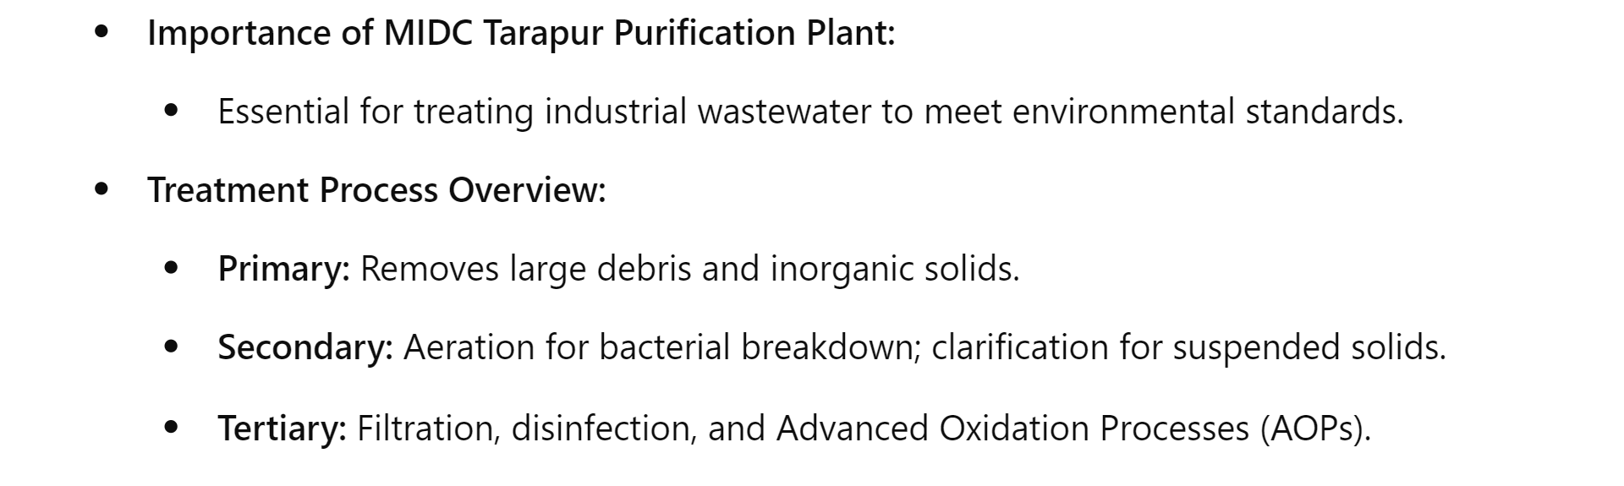
Summary / Overview

Slide 10
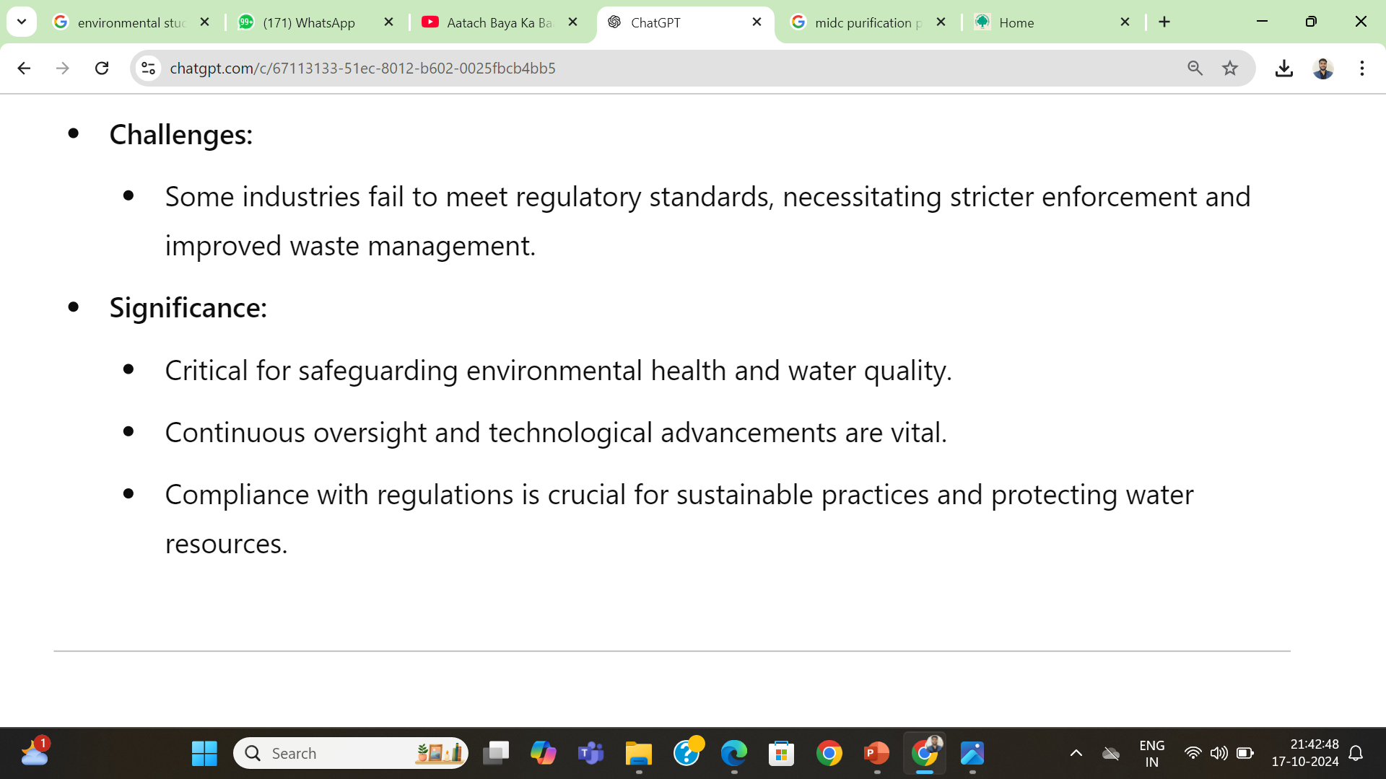
Conclusion

Slide 11
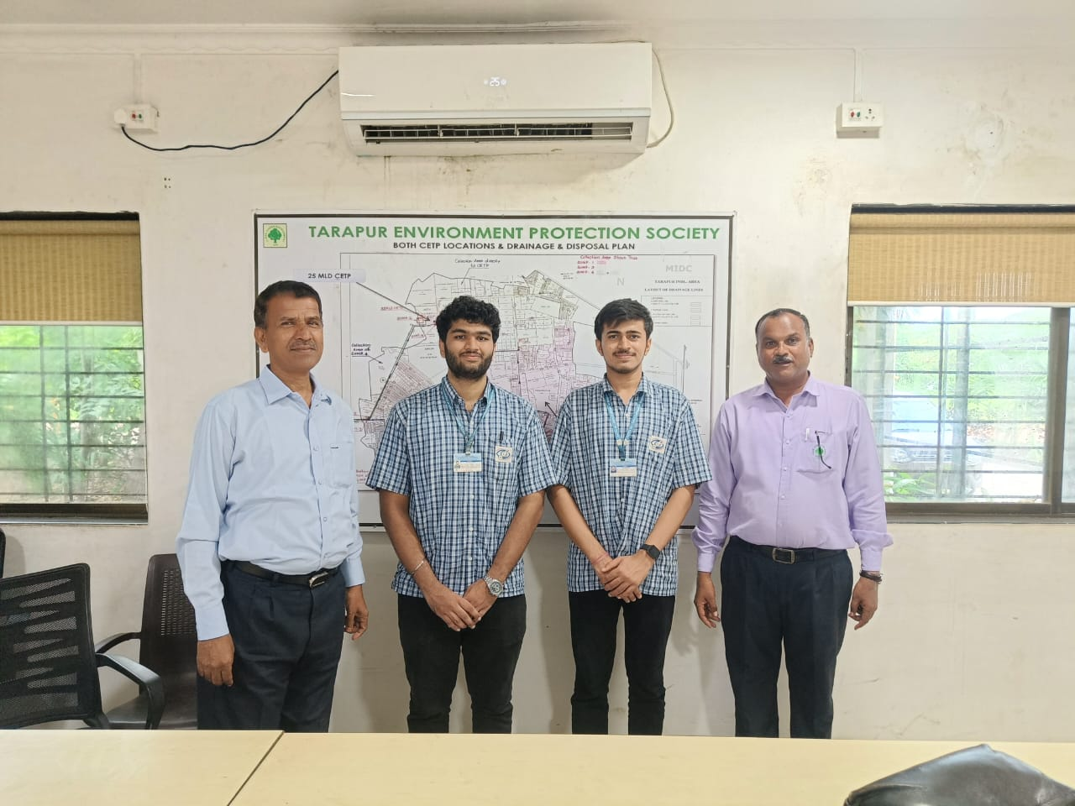

Slide 12


